Slide 1
AGENT FOUNDATION
What is an AI Agent?
From LLMs to Autonomous Agents
Multi-Agent Deep RAG Course

Slide 2
LLM vs Agent: What's the Difference?
💬 Large Language Model
🤖 AI Agent
Nature: Passive responder
Nature: Autonomous actor
Capability: Text in → Text out
Capability: Perceives + Acts + Reasons
• Predicts next token
• Single-turn response
• No memory
• Cannot take actions
• Uses LLM as brain
• Multi-turn iterative
• Maintains memory
• Uses external tools
Example: Generates answer from patterns
Example: Uses calculator tool for exact answer
🎯 Key Insight: Agent = LLM (brain) + Memory + Tools + Planning

Slide 3
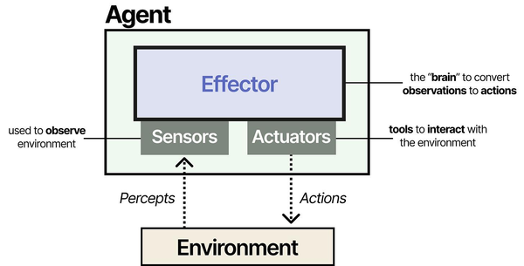
Core Components
of an AI Agent
"An agent is anything that can be viewed as perceiving its environment through sensors and acting upon that environment through actuators."
🧠
👁️
🛠️
🌍
Effector (Brain)
Sensors
Actuators (Tools)
Environment
• Reasoning LLM
• Decides actions
• Processes observations
• Plans next steps
• Multimodal inputs
• User queries
• Tool outputs
• Environmental state
• External APIs
• Databases
• Web search
• Code execution
• Digital/physical world
• User interactions
• Data sources
• Other agents

Slide 4
Four Types of AI Agents
1️⃣ ReAct Agent
2️⃣ Plan-Execute Agent
Pattern: Reason → Act → Observe
Pattern: Plan → Execute → Replan
• Most common pattern
• Alternates reasoning and acting
• Simple and effective
• Creates complete plan upfront
• Executes steps sequentially
• Can revise based on outcomes
Use Case: Q&A, data retrieval
Use Case: Research, reports, workflows
3️⃣ Multi-Tool Agent
4️⃣ Self-Corrective Agent
Pattern: Tool Selection → Parallel
Pattern: Act → Validate → Correct
• Multiple specialized tools
• Dynamic tool selection
• Can use tools in parallel
• Validates own outputs
• Detects and fixes errors
• Iteratively improves
Use Case: Data analysis, automation
Use Case: Code gen, SQL, critical tasks

Slide 5
The Agent Loop (ReAct Pattern)
Think → Tool → Think → Answer
1
🤔 Think (Reasoning)
Agent analyzes query and decides approach
2
🛠️ Tool (Action)
Agent executes tool and gets observation
3
🔍 Think (Reflection)
Agent reflects on observation and plans next step
4
✅ Answer (Finish)
Agent generates final response
⚡ Iterative • Dynamic • Autonomous

